Slide 1
Oil pipeline accidents
Chethan M (PES2201800331)
Anirudh R (PES2201800068)

Slide 2
Abstract
Oil is by far the most commonly spilled substance . Since 1986 pipeline
accidents have spilled an average of 76,000 barrels per year or more than
3 million gallons. This is equivalent to 200 barrels every day. Oil pipeline
accidents not only leads to the wastage of crude oil but also has adverse
effects on the environment by contaminating the water and land, leading to
water pollution and soil pollution. It also affects the economy of thecountry
as the repairs caused by the accident is huge. Oil leakages in the ocean
toxicate aquatic animals and plants thereby affecting the aquatic
ecosystem.Oil being a fossil fuel takes millions of years to form , should be
transported carefully with adequate measures to prevent leakage.Data
collected from various sources helps us to infer on the causes related to oil
pipeline accidents.

Slide 3
Dataset dataset link: https://www.kaggle.com/usdot/pipeline-accidents
Accidents dataset: This database includes a record for each oil pipeline leak or spill. These records include the incident date and time, operator and pipeline, cause of incident, type of hazardous liquid and quantity lost, injuries and fatalities, and associated costs. It has 2796 rows and 48 columns.

Slide 4
Variable description
S.No | Name & description | Type
1 | Report number | integer
2 | Supplemental number | Integer
3 | Accident year | Integer
4 | Accident date/time | integer
5 | Operator ID | integer
6 | Operator name | String
7 | Pipeline/facility name | String
8 | Pipeline location | String
9 | Pipeline type | String
10 | Liquid type | String
11 | Liquid subtype | String
12 | Liquid name | String

Slide 5
S.No | Name & Description | Type
13 | Accident city | String
14 | Accident county | String
15 | Accident state | String
16 | Accident latitude | Float
17 | Accident longitude | Float
18 | Cause category | String
19 | Cause subcategory | String
20 | Unintentional release | Integer
21 | Intentional release | Integer
22 | Liquid recovery | Integer
23 | Net loss | Integer
24 | Liquid ignition | String
25 | Liquid explosion | String

Slide 6
S.No | Name & Description |  | Type
26 | Pipeline shutdown |  | String
27 | Shutdown date/time |  | Integer
28 | Restart date/time |  | Integer
29 | Public evacuations |  | Integer
30 | Operator employee/injuries |  | Integer
31 | Operator contractor injuries |  | String
32 | Emergency responder injuries |  | integer
33 | Other injuries |  | Integer
34 | Public injuries |  | Integer
35 | All injuries |  | Integer
36 | Operator employee fatalities |  | integer
37 | Operator contractor fatalities |  | Integer
38 | Emergency responder fatalities |  | Integer
39 | Other fatalities |  | integer

Slide 7
S.No | Name & Description | Type
40 | Public fatalities | integer
41 | All fatalities | Integer
42 | Property damage costs | Integer
43 | Lost commodity costs | Integer
44 | Property damage costs | Integer
45 | Emergency response costs | Integer
46 | Environmental remediation costs | Integer
47 | Other costs | Integer
48 | All costs | Integer

Slide 8
OBJECTIVES
Pie chart for number of accidents in each year
Pie chart representing amount of accidents for each cause
Bar graph to represent the number of accidents in onshore and offshore

Slide 9
LITERATURE SURVEY - 1
Title: The Monitoring system of leakage accidents in crude oil pipelines.
Authors: Jianning ding, juanwen dang, Ninigi yuan, Qiaoling pan.
Link: https://ieeexplore.ieee.org/document/5987303/

Slide 10
KEY POINTS
Earlier – communication cables
- Detect leakage
- Expensive and difficult to maintain
Now - ZIG-BEE Technology
- Wireless sensor network system
- Pressure sensors installed at every pipeline valve
- Detects the leakage when there is negative pressure in the pipeline
- Sends the warning signal immediately to the operator

Slide 11
HARDWARE AND SOFTWARE
Hardware
Resistors
Capacitors
Inductors
Digital controlled oscillator (DCO)
Software design
Sensor Node – Collects data
Routing Node - Transmits data
Sink Node - Sends data to the PC and operator

Slide 12
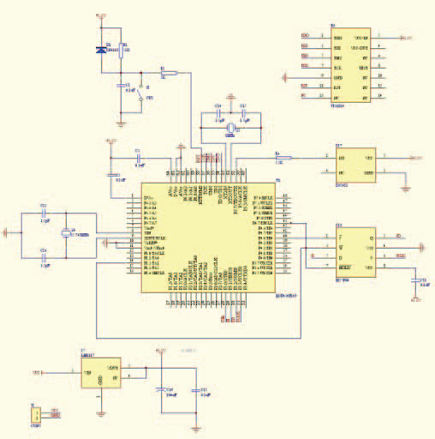
Circuit

Slide 13
Literature survey-2
Title:An overview of pipeline leak detection and location systems
Authors:Lawerence Boaz,Shubi kaijage.
Abstract: Leak detection in transmission pipelines is crucially important for safe operation. Delay in detecting leaks leads to loss of property and human life in fire hazards and loss of valuable material.
Pipeline leak detection systems play a key role in minimization of the probability of occurrence of leaks and hence their impacts.

Slide 14
Literature Survey-2
External | Internal
Fibre optic cable | Pressure point analysis
Acoustic sensor | Mass balance method
Statistical system | Statistical system
Video Monitoring | RTTM and e-RTTM

Slide 15
Fibre optic cable: it takes temperature measurements over the entire pipeline length. This method provides accurate leakage detection and location, the major limitation is the limited length of cable.
Acoustic systems: It is based on the principle that escaping liquid creates an acoustic signal (sound) as it passes through a perforation in the pipe. This method has the advantages of high detection and localization accuracy but the system require large number of sensors for longer pipelines.
Sensor hoses: The material reacts when in contact with the medium to be detected to produce a substance being capable of diffusion and being detectable. The system is capable of detecting small leaks, but it is useful for short pipelines.

Slide 16
Literature Survey-2
Video monitoring: Pipeline video inspection is a form of telepresence used to visually inspect the pipelines. A common application is to determine the condition of small diameter sewer lines and household connection pipes.
Internal
Pressure point analysis:The pressure point analysis leak detection method is based on the statistical properties of a series of pressure or velocity pipeline measurements at one point being different before and after a leak occurs.
Mass Balance Method:Mass or Volume balance are in effect the same technique based on the principle of conservation of mass. The principle states that a fluid that enters the pipe section either remains in the pipe section or leaves the pipe section.

Slide 17
Literature Survey-2
Statistical Systems: Statistical Leak Detection Systems use methods and processes from decision theory.An alarm limit(y) is set based on decision theory.
RTTM based system :RTTM stands for Real-Time Transient Model, detect leakage in the pipeline using mathematical models based on physical laws such as conservation of mass, conservation of momentum and conservation of energy. This calculated flow is then compared to the measured flow. If the difference is greater than zero it means leakage is occurred.
CONCLUSION: Considering the limitation of continuous LDSs i.e., both internal and external LDSs it is worthwhile installing two parallel functioning LDSs for better results.

Slide 18
Data cleaning
sum(is.na(data))#check for missing values data[!complete.cases(data),] #list data rows that has missing values data$Public.Evacuations[is.na(data$Public.Evacuations)]=0 data$Operator.Employee.Injuries[is.na(data$Operator.Employee.Injuries)]=0 #DELETED COLUMNS data$Operator.Contractor.Injuries=NULL data$Emergency.Responder.Injuries=NULL data$Other.Injuries=NULL data$Public.Injuries=NULL data$All.Injuries=NULL data$Operator.Employee.Fatalities=NULL data$Operator.Contractor.Fatalities=NULL data$Emergency.Responder.Fatalities=NULL data$Other.Fatalities=NULL data$Public.Fatalities=NULL data$All.Fatalities=NULL

Slide 19
Data cleaning
#setting NA values zero data$Property.Damage.Costs[is.na(data$Property.Damage.Costs)]=0 data$Lost.Commodity.Costs[is.na(data$Lost.Commodity.Costs)]=0 data$Public.Private.Property.Damage.Costs[is.na(data$Public.Private.Property.Damage.Costs)]=0 data$Emergency.Response.Costs[is.na(data$Emergency.Response.Costs)]=0 data$Environmental.Remediation.Costs[is.na(data$Environmental.Remediation.Costs)]=0 data$Other.Costs[is.na(data$Other.Costs)]=0 #Removing Rows of further NA values data=na.omit(data) write.csv(data,"new.csv")

Slide 20
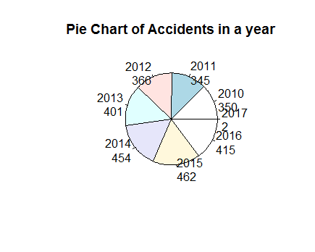
Data exploration
Accidents in a year

Slide 21
INTERPRETATION
Age factor
- On an avg, pipeline accidents occur on pipes that are more than 33 yrs old.
Hazardous Liquids
- Pipelines that carry hazardous liquids and are more than 27 yrs old are more prone to accidents due to equipment failure and incorrect operation.

Slide 22
Code
mytable <- table(oilpipeline$Accident.Year)
lbls <- paste(names(mytable), "\n", mytable, sep="")
pie(mytable, labels = lbls,
main="Pie Chart of Accidents in a year")

Slide 23
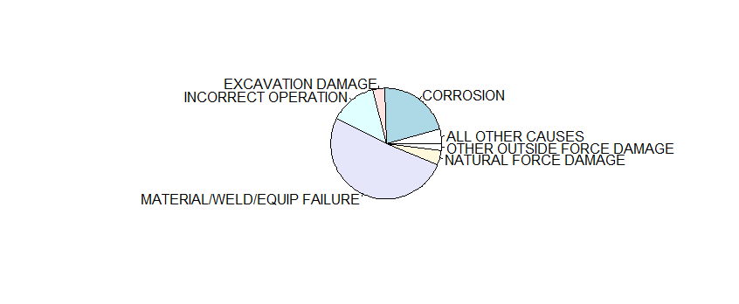
Cause category

Slide 24
Interpretation
More than 50% of pipeline accidents occur due to EQUIPMENT FAILURE......
- Usage of flammable and explosive substances in operating procedure
- Bad quality of material used by the companies while construction
- Existence of mechanical impurities in
oil, causing abrasion of pipelines

Slide 25
code
pie(table(oilpipeline$Cause.Category))

Slide 26
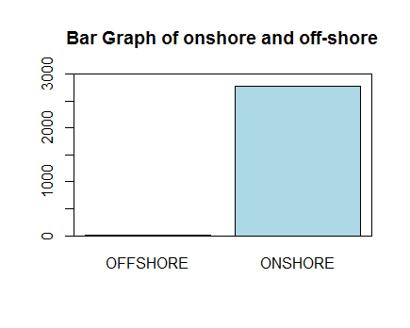
Onshore and offshore

Slide 27
Interpretaion
OFFSHORE accidents are less
- Protected from seawater corrosion by a coating (cathodic protection)
- Constant atmospheric pressure and density
Almost 90% of accidents occur in ONSHORE
- Hot atmosphere conditions
- Corrosion

Slide 28
Code
barplot(table(oilpipeline$Pipeline.Location),
ylim=c(0,3000),
main = "Bar Graph of onshore and off-shore",
col = "lightblue")
box(which = "plot",
lty = "solid",
col="black")
#shows that accidents didnt occur on offshore

Slide 29
Data visualisation(II)

Slide 30
Insights
OFFSHORE accidents are less
- Protected from seawater corrosion by a coating (cathodic protection)
- Constant atmospheric pressure and density
Almost 90% of accidents occur in ONSHORE
- Hot atmosphere conditions
- Corrosion

Slide 31
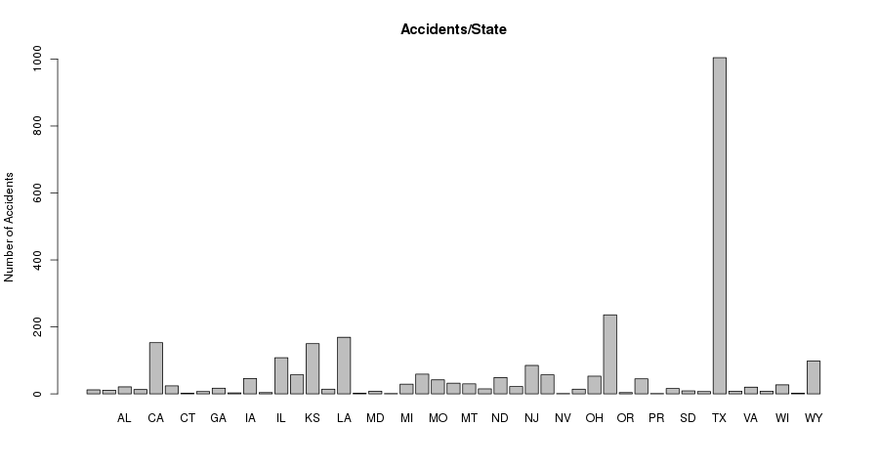
Data visualisation(II)

Slide 32
Insights
Texas has recorded the most number of oil pipeline accidents.
Since 2014, Oil productivity and new pipelines installations have been increasing by double the amount every year.
All there pipelines are constructed above ground and hence the accidents are also more in Texas.

Slide 33
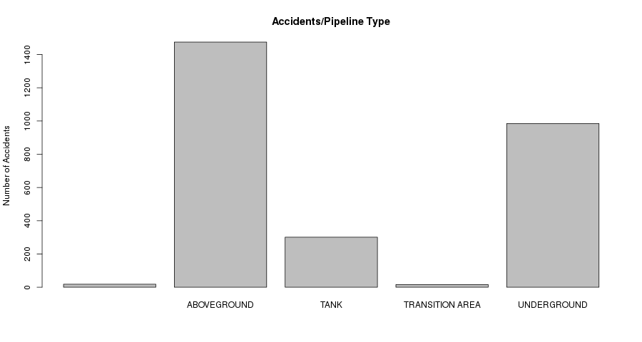
Data visualisation(II)

Slide 34
Insights
More density changes in above ground Oil pipelines.
They get easily corroded.
Hot atmospheric conditions.

Slide 35
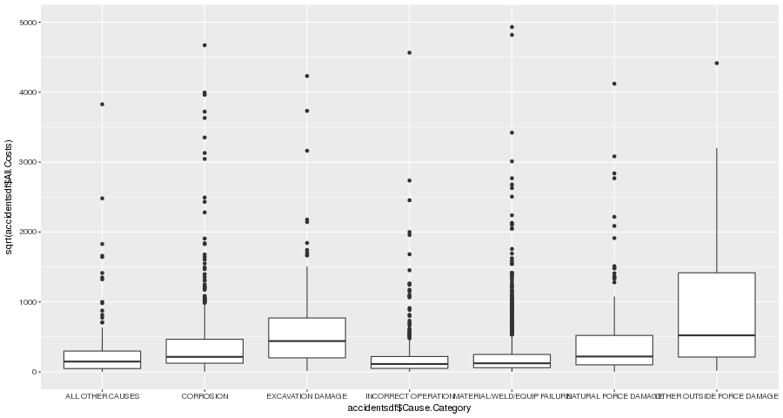
Data visualisation(II)

Slide 36
Insights
This graph shows that accidents caused by corrosion, excavation damage are costly to repair
The corroded oil pipeline has to be replaced with the new one, so it turns to be costly.
It costs an average of$2,50,000 to repair the damaged pipeline.

Slide 37
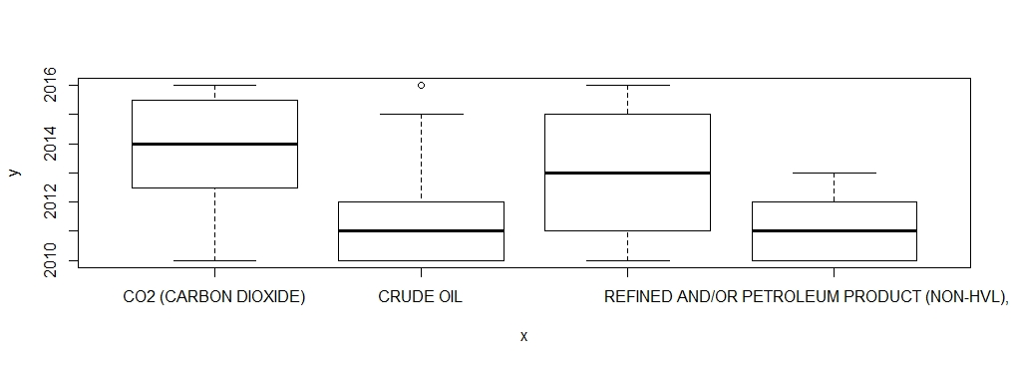
Data visualisation(II)

Slide 38
Insights
Carbon dioxide and HVL(High viscosity lubricant) pipelines are the most affected.
Carbon dioxide pipelines combine with the metals in the pipelines forming oxides and carbonates thereby losing its properties.
High viscosity liquids exert more liquid pressure on the pipelines, so they tend to break faster and cause oil leakage.

Slide 39
Linear Regression Model
Linear regression is used to predict the value of a continuous variable Y based on one or more input predictor variables X.
The aim of Linear Regression is to find a mathematical equation for a continuous response variable Y as a function of one or more X variable(s).
Y=aX+bY+....+intercept

Slide 40
Modelling
The dataset is split into 2 parts
80% data
20% data
op=read.csv("datasetmain.csv")
library(caTools)
split=sample.split(op,SplitRatio = 0.8)
train=subset(op,split="TRUE")
test=subset(op,split="FALSE")

Slide 41
Modelling-1
Linear Regression will be modelled on the dataset that contains 80% of values (train).
Predictions will be made on the dataset that contains 20% of values (test).
4 variables are used for modelling here :
Intentional oil loss
Unintentional oil loss
Oil recovery
Net loss

Slide 42

Creating the Model
net=train$Net.Loss..Barrels.
unint=train$Unintentional.Release..Barrels.
rec=train$Liquid.Recovery..Barrels.
int=train$Intentional.Release..Barrels.
model=lm(net~(unint+int+rec),data=train)
summary(model)

Slide 43

Significance of Model
P-Value =2.2e-16 < 0.05
Standard Error – measures the goodness of fit.
SE= 4.781e-12 (almost 0)
R squared – proportion of variation in dependent variables.
= 1 ( >0.70 )

Slide 44
Correlation
Correlation between unintentional and net loss
is 0.509=50.9% related.
Correlation between intentional and net loss
=0.855=85.5% related.
Correlation between Liquid recovery and net loss
=0.034=3.4% related.

Slide 45
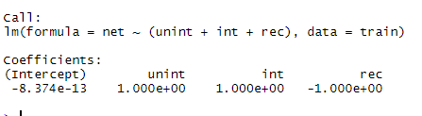
The model
Hence, the model is significant
Net = unint + int - rec – 8.374e-13

Slide 46

Prediction
pred=predict(model,test)
plot(test$Net.Loss..Barrels.,type="l",lty=1.8,col="red")
plot(pred,type="l",lty=1.8,col=“blue")
----------------The data-values are almost similar-------------

Slide 47
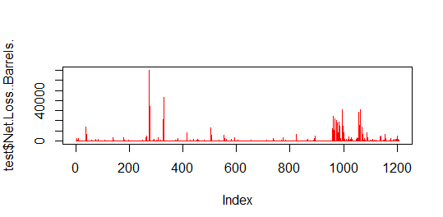
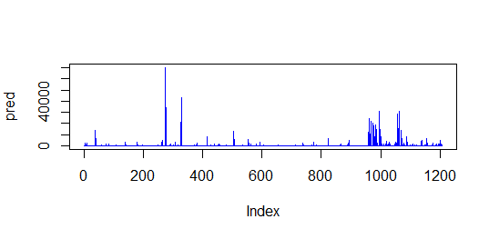
Prediction

Slide 48
Modelling-2
Linear regression will be modelled on the dataset that contains 80% of values.
Predictions will be made on the dataset that contains 20% of values
6 variables are used for modelling
Property damage costs
Lost commodity costs
Public private property costs
Emergency costs
Environment Remediation costs
Other costs

Slide 49
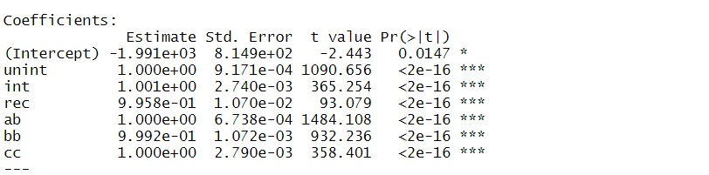
Creating the model
net=train$All.Costs
unint=train$Property.Damage.Costs
rec=train$Lost.Commodity.Costs
int=train$Public.Private.Property.Damage.Costs
ab=train$Emergency.Response.Costs
bb=train$Environmental.Remediation.Costs
cc=train$Other.Costs
model=lm(net~(unint+int+rec+ab+bb+cc),data=train)
Summary(model)

Slide 50


Significance of model
P-value:2.2e-16<0.05
Standard error=measure the goodness of fit.
S.E=9.206e-12(almost 0)
R squared-proportion of variation in dependent variables.=1>(0.70)

Slide 51
corelation
Corelation between allcosts and property damage costs is0.377=37.7% related.
Corelation between allcosts and Lost commodity costs is0.198=19.8% related.
Corelation between allcosts and pubic damge costs is0.712=71.2% related.
Corelation between allcosts and property damage costs is0.377=37.7% related.
Corelation between allcosts and emergency response costs 0.947=94.7%related.
Corelation between allcosts and environment remediation costs 0.420=42%related.
Corelation between allcosts and other costs 0.892=89.2%related.

Slide 52
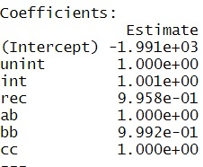
The model
Hence the model is significant
Allcosts=unint+int+rec+ab+bb+cc-1.99e+03

Slide 53

Prediction
pred=predict(model,test)
plot(pred,type="l",lty=1.8,col="red")
lines(pred,type="l",col="blue")
The data values are almost similar

Slide 54
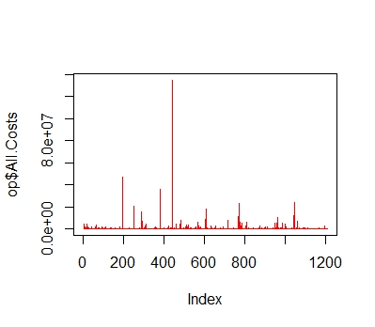
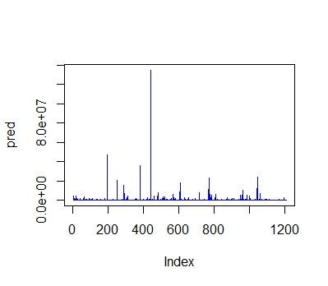
Prediction

Slide 55
Thank you

